Slide 1



WellBot – Milestone Review
AI-Based Wellness Chatbot System
Presented By: Wellness Chat Bot Team A
1

Slide 2

Mental Health Accessibility Gap
Increasing demand for 24/7 mental health support
Limited availability of traditional services
Accessibility barriers due to social stigma
Need for private, AI-driven emotional assistance
2

Slide 3






Core Purpose & Objectives
Wellness Support
Habit & Mood
User Interface
Providing empathetic AI companionship and support.
Tracking stress levels and cultivating healthy habits.
Minimalist, user-friendly, and accessible design.
3

Slide 4




WellBot’s Unique Value
24/7 AI Assistance
Privacy-First
Instant responses for people feeling isolated or uncomfortable seeking human help.
Secure platform with emotional monitoring and data protection at its core.
4

Slide 5

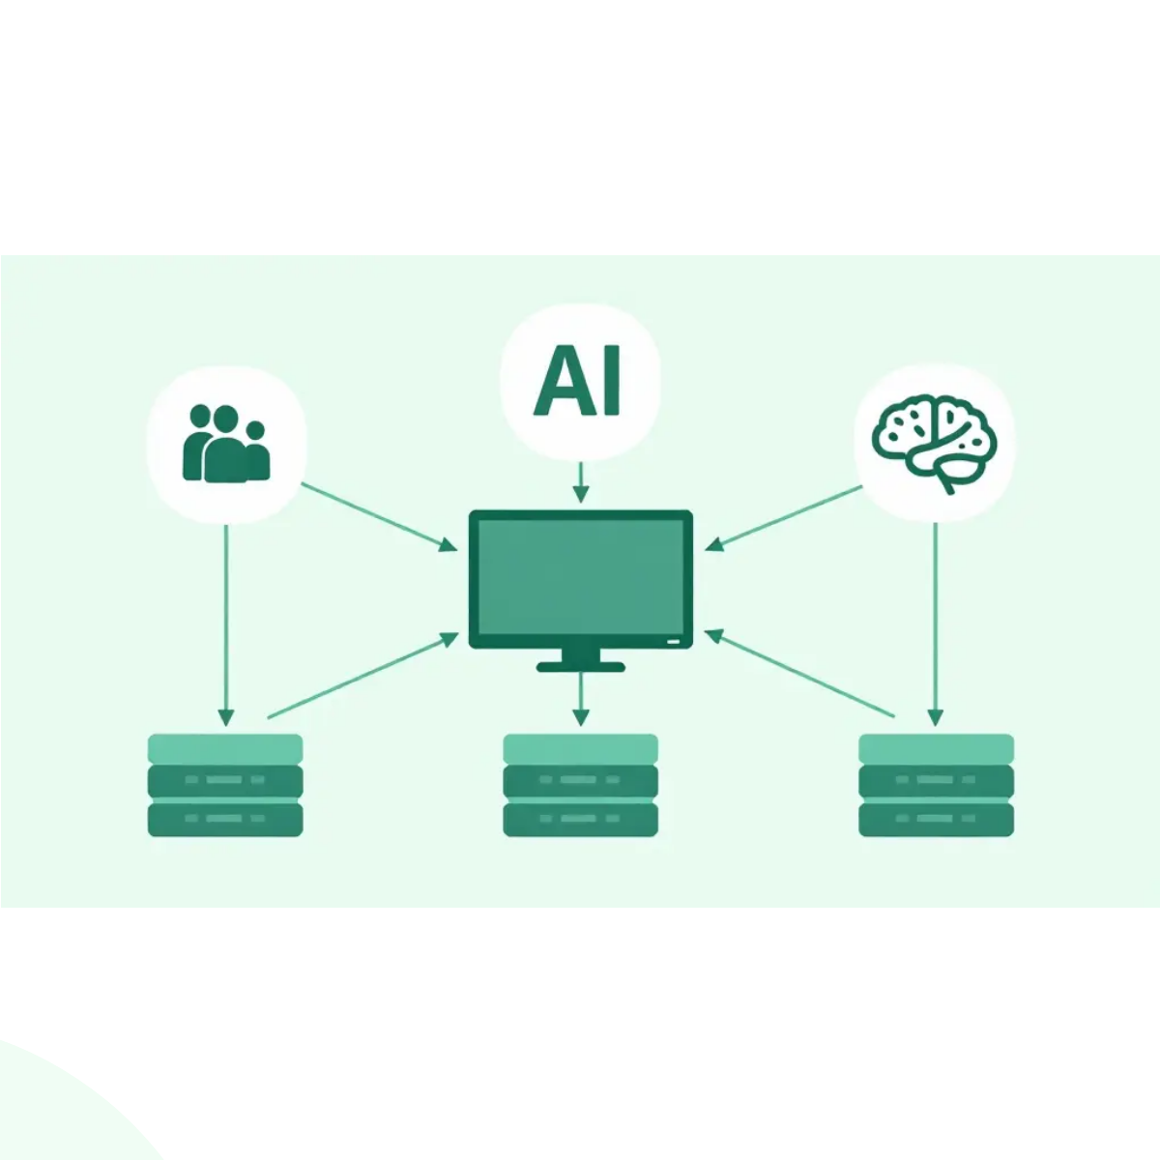
System Architecture Overview
Flask Backend: Core logic and API management.
Safety Filter: Real-time content moderation.
OpenAI GPT-3.5: Advanced NLP for empathetic chat.
MongoDB: Scalable storage for user data and chats.
5

Slide 6




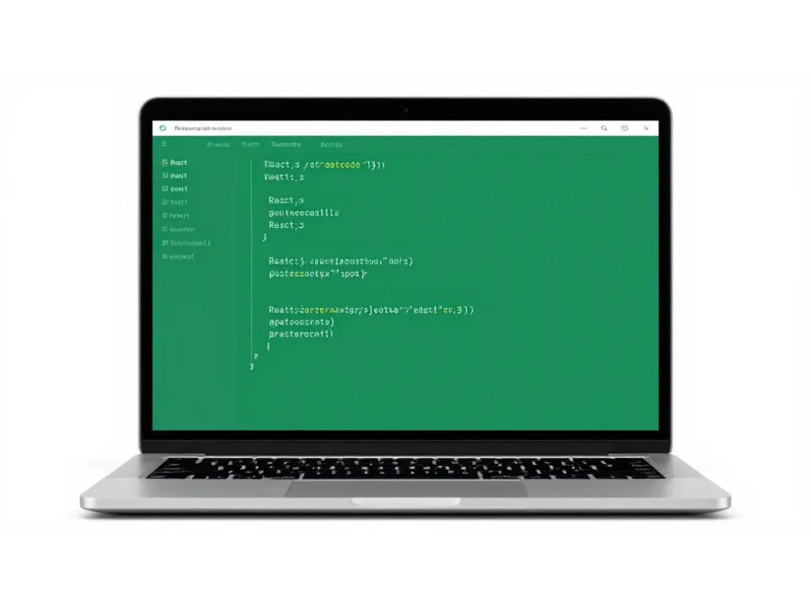




Technology Stack
Frontend: Html, Css & JS
Backend: Flask & MongoDB
Styling: Glassmorphism
6

Slide 7



Security & Authentication
Google OAuth
SHA-256 Hashing
Crisis Detection
Secure and seamless third-party authentication.
Advanced encryption for sensitive user data.
Keyword monitoring for immediate safety alerts.
7

Slide 8

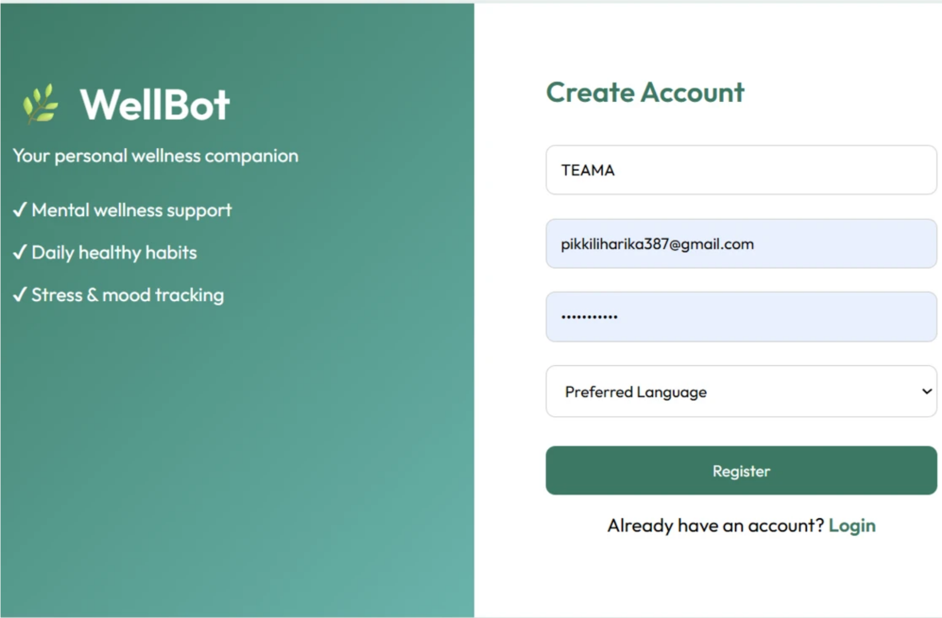

Registration Interface
Onboarding Experience
Interactive mascot behavior for user engagement.
Smart input fields with real-time validation.
Dynamic password strength meter.
Clear, step-by-step guidance for new users.
8

Slide 9

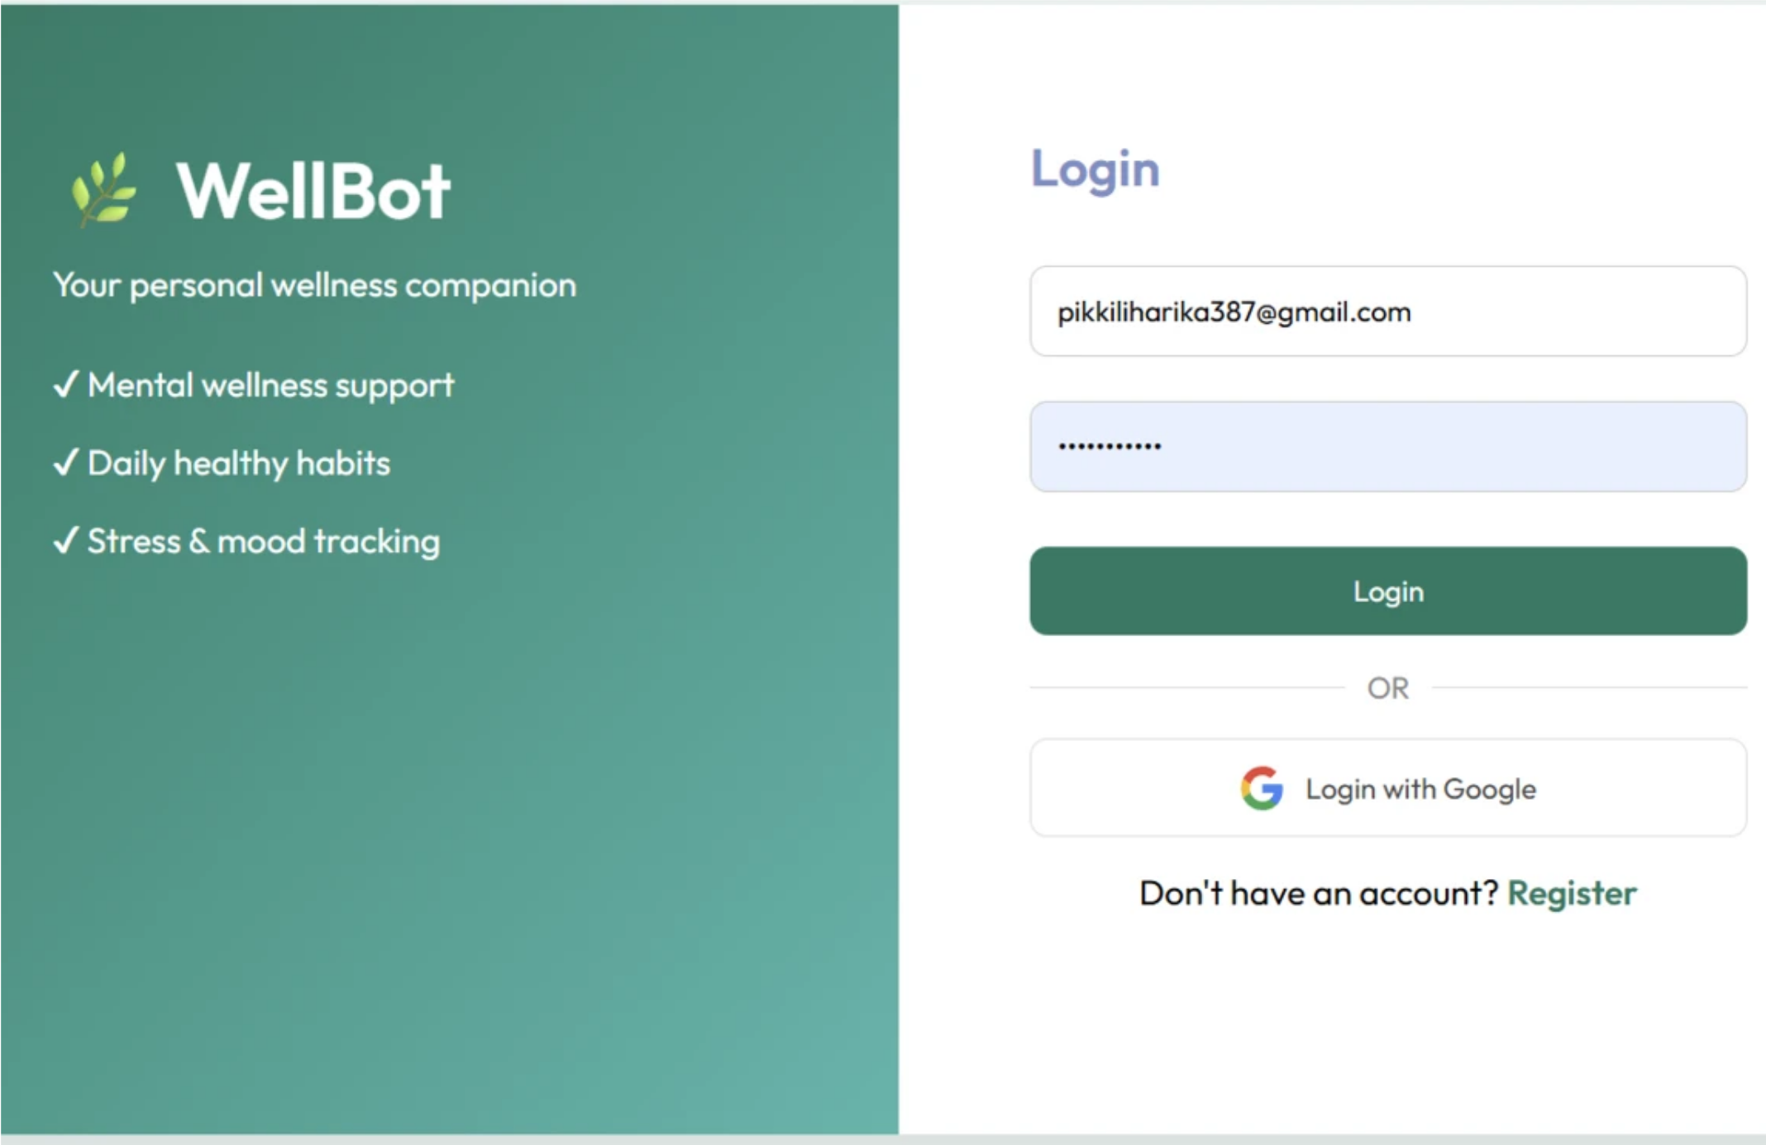

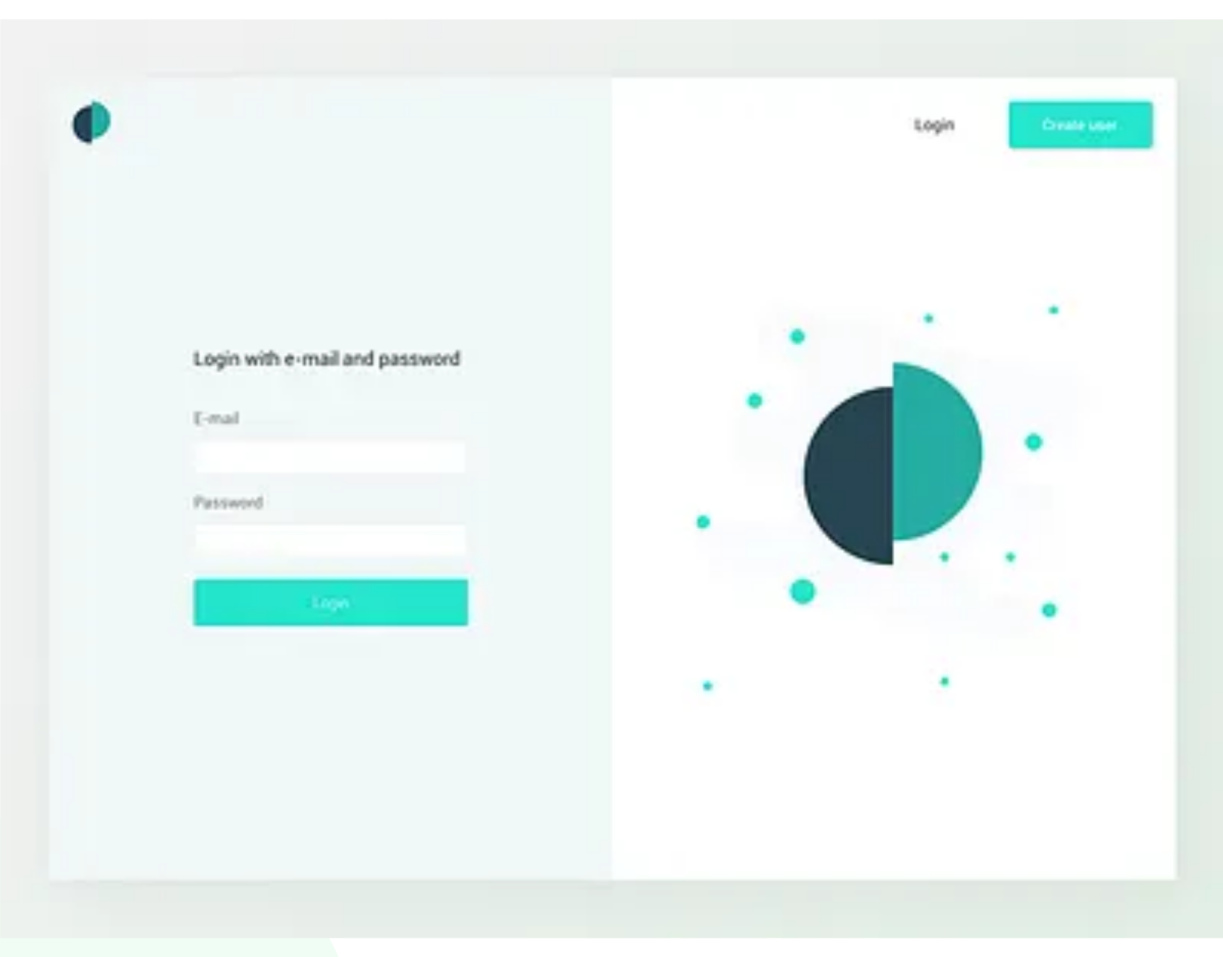
Login Interface
Seamless Access
Elegant two-panel split layout design.
One-tap secure Google OAuth integration.
Fully responsive design for mobile & web.
Remember-me functionality and secure reset.
9

Slide 10
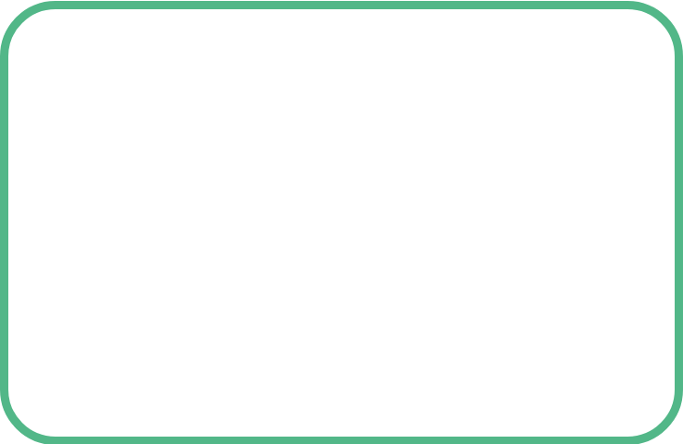



Milestone Progress Summary
Backend
Auth
AI Core
Frontend
Flask Setup & MongoDB Connected
Google OAuth & SHA-256 Integrated
OpenAI API & Safety Filter Live
100% Functional Responsive UI
10

Slide 11
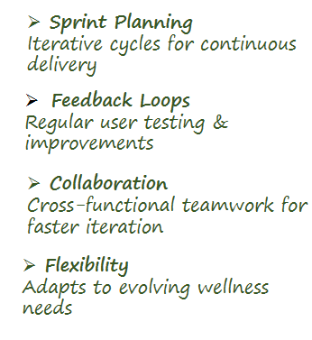
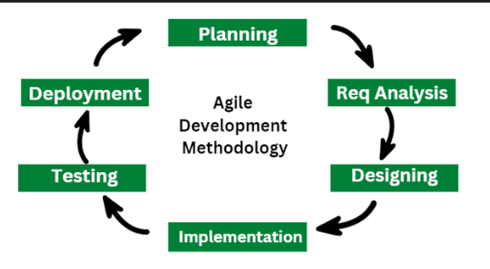
Agile Development Approach
11

Slide 12
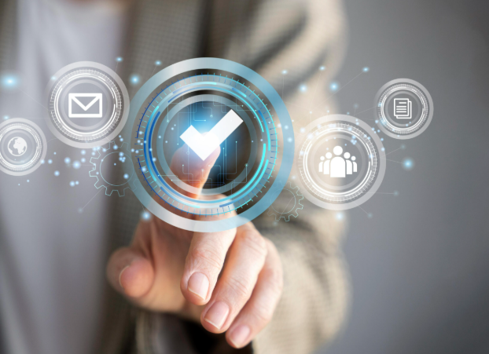
Testing & Validation Framework
Security Validation
OAuth, SHA-256, crisis detection checks
Usability Testing
Minimalist UI validated across devices
Performance Testing
Flask + MongoDB load handling
Example Test Case
Input: “I feel anxious.”
Output: Empathetic response + stress log update
12

Slide 13

Conclusion
WellBot bridges the mental health gap with AI intelligence, secure authentication, and a wellness-driven interface.
Thank You
11

